Slide 1
Stock Value prediction using Regression Algorithms

Slide 2
Team Members:
Sai Prakash Tummala – 700734539
Sheshwanth Gundeti -700741055
Rahul Reddy Aleti -700742994
Kanaka Sai Subramanya Trinadh Samudrala-700732185

Slide 3
Role& Contribution
Sai Prakash Tummala worked on identifying the necessary papers for the project implementation.
Sheshwanth Gundeti dataset collection based on the column names required for the project.
Rahul Reddy Aleti implemented the coding for loading dataset.
Kanaka Sai Subramanya Trinadh Samudrala worked on the documentation what we have done.

Slide 4
Motivation
forecasting share prices, cutting-edge intelligence approaches relying whether on technological or fundamental evaluation have become widely utilized.
researching the price of stocks forecasting because it can really be hugely profitable.
Predicting equity markets is an established yet significant challenge.

Slide 5
Objective
forecast future changes in a commercial lender's share price.
Predicting the future stock price using regression algorithms such as linear and polynomial
establish a link here between aspects of the organization We could evaluate and even the share value

Slide 6
Related work
Fundamental analysis:
company's shares through looking there at inherent worth.
basic analysis uses combined recent and historical data.
short-term information has little influence on the findings of underlying analyses.
Technical Analysis:
technical analysis concentrates upon regarding previous information, although it has been mostly utilized at the day trade.
by analyzing quantitative metrics from actions mostly on financial markets, including such asset values, past profits, including transaction volume.

Slide 7
Problem Statement
SFT’s stocks are listed on NASDAQ and their value is updated every working day of the stock market. It should be noted that the market does not allow trading on Saturdays and Sundays, therefore there is a gap between the two dates. The Opening Value of the stock, the Highest and Lowest values of that stock on the same days, as well as the Closing Value at the end of the day, are all indicated for each date.
The Adjusted Close Value reflects the stock’s value after dividends have been declared (too technical!). Furthermore, the total volume of the stocks in the market is provided, With this information, it is up to the job of a Machine Learning/Data Scientist to look at the data and develop different algorithms that may extract patterns from the historical data of the Microsoft Corporation stock.

Slide 8
Proposed solution
Linear regression:
less susceptible to require stabilizing
linear regression generally produced findings that were tenable following standardization without the need for factor modification
Polynomial Regression:
possess non-linear data.
linear regression is unable to create a finest line.
reveals underlying curved connection among independent and dependent parameters.

Slide 9

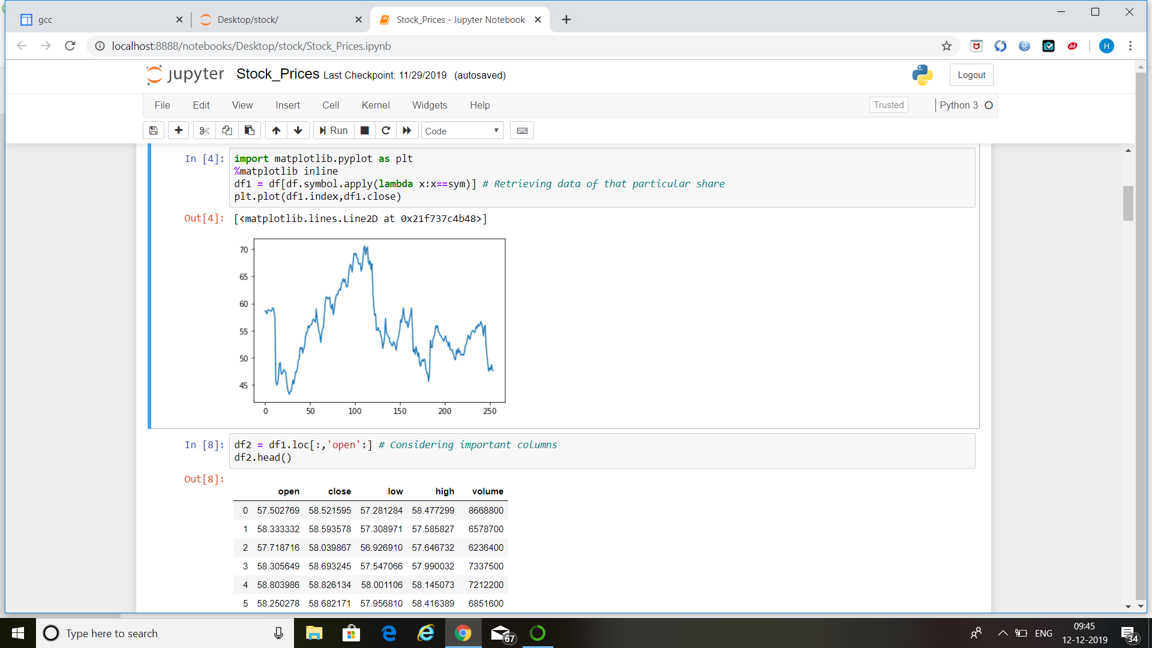
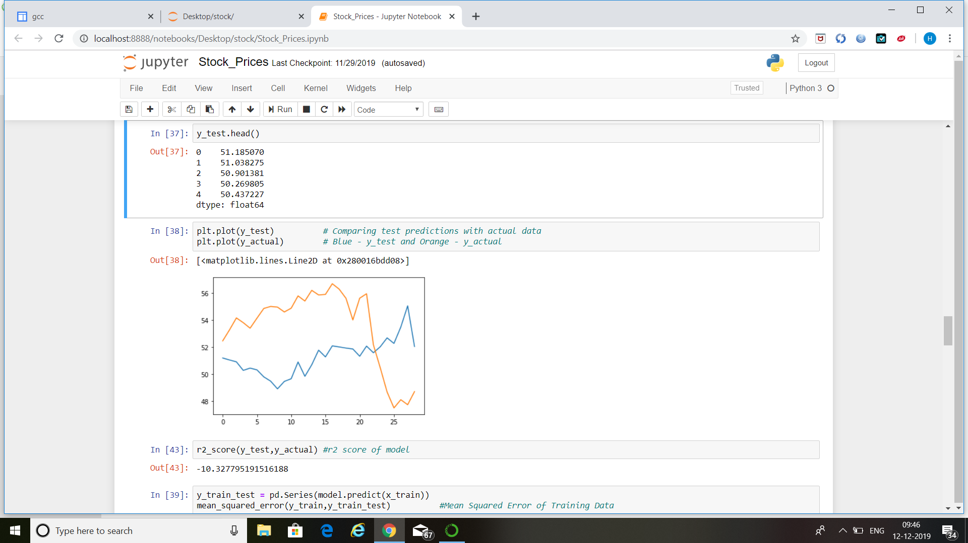
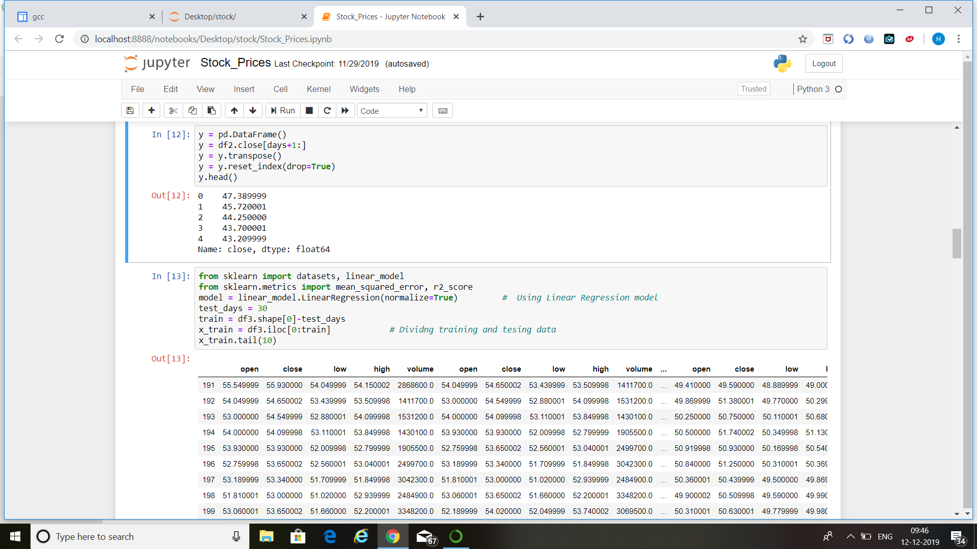
Results
Training and testing data division.
Visualisation of particular stock
Comparing the predicted stock with actual values

Slide 10
References:
R. S. Dhankar, Capital Markets and Investment Decision Making, 1st ed. Springer India, 2019, ch. Stock Market Operations and Long-Run Reversal Effect.
M. Usmani, S. H. Adil, K. Raza, and S. S. A. Ali, “Stock market prediction using machine learning techniques,” in 2016 3rd International Conference on Computer and Information Sciences (ICCOINS), Aug 2016, pp. 322–327.
H. Grigoryan, “A stock market prediction method based on support vector machines (svm) and independent component analysis (ica),” Database Systems Journal, vol. 7, no. 1, pp. 12–21, 2016.
S. Hansun, “A new approach of moving average method in time series analysis,” in 2013 International Conference on New Media Studies, CoNMedia 2013 Nov 2013, pp. 1–4.

